Slide 1
A Pair of Guide Robots for MCECS
Marek Perkowski

Slide 2
Goal of our projects
We develop two intelligent autonomous robot Guides that will give guided tours to the MCECS at PSU
and be able to lead a user to a sequence of specific locations in the basement area of the Engineering Building and the Fourth Avenue Building at Portland State University.

Slide 3
Sequence of projects
PeopleBot
2010
GuideBot
2011
MCECS_Bot
2012 - 2013

Slide 4
Figure 6. MCECS-Bot system

Slide 5
Planned Features of the MCECS-BOT.
The robot is in a standing position and has a head with face and a pair of arms to express emotions.
Guests are able to interact with MCECS-BOT
using on input to the robot:
speech recognition,
touchscreen,
vision-guided recognition of a human gestures,
vision-guided recognition of facial emotions.
using on output to the robot:
speech synthesis,
touchscreen for display of text and graphs,
facial expressions of the robot,
hand gestures of the robot,
body gestures of the robot,
Scooter-based control of the robot.
3. The guests ask to be directed to a particular classroom, location, laboratory or office within the basement floor of the EB and FAB.

Slide 6
Planned Features.
Navigation Principles.
Once MCECS-BOT understands the person’s request, it will:
autonomously navigate the building,
safely navigate the building (do not harm humans, walls, furniture)
reach the sequence of requested locations,
return to the robot’s base (where will be this base?).
Natural Language conversation
MCECS-BOT is able to communicate in a subset of English
Communicate standard greetings in Chinese, Spanish, German and other languages of potential visitors.
This conversation will be also related to self-diagnostics of the robot hardware/software system.
Conversely, users can interact with and give commands to MCECS-BOT using speech by means of a set of keywords and simple English sentences.
Semantic Knowledge
The robot advertises the engineering programs at PSU
The robot answers in English standard questions like sizes of classes, or types of degrees awarded.
The robot has access to Internet to gain new knowledge
The robot will have semantic network and some kind of Artificial Intelligence for simple associations and reasonings (to be discussed what).
The robot can do some simple calculations when asked, such as averages, etc.

Slide 7
Planned Features.
Person Detection
The robot detects the presence of a person using the face detection and tracking algorithms.
8. Person Identification
The robot identifies:
The age
The gender
The facial emotions
The hand gestures
The face from the data base (dean, chair, other)
Motion and Navigation details
Navigate the hallways
Avoid hitting people and other obstacles
Use sonar, infra-red sensors, and input from two Kinect vision systems.
The knowledge of the basement area of the Engineering Building/Fourth Avenue Building is manually programmed
An automatic mapping algorithm is also implemented such that MCECS-BOT is be able to build its own map and explore new areas.
Extension of the robot’s software is also possible such that the robot will be also to
use the elevators to visit other floors.
open doors of corridors, rooms and elevator.

Slide 8
Planned Features: Head and Neck.
Head and neck
For the head of the robot we propose a mobile tablet (in addition to the touchscreen) that will display an illustrated/cartoon character face showing multiple facial expressions or a puppet/Muppet-like face with one or more degrees of freedom for facial expressions.
The head will be attached to the torso by a neck with three degrees of freedom.
Together with the movements of the neck/head and torso, the facial expression will make the interaction with MCECS-BOT more engaging to the user.
We have experience with several other types of heads from previous robots, but we have never tried this type, which for several reasons (robust design, no need to tune, high reliability) is the best choice.

Slide 9
Planned Features.
Internet access.
The project will be completely connected to the PAVE frame on Internet (developed by Prof. Fei Xie from CS and his team).
This way, our robot and PSU labs will be visible from the entire world and viewers from other countries will be able to control the robot.
Software
Public-Domain and University research application software will be used whenever possible
We will utilize open-source system software as much as possible. MCECS-BOT will run under Ubuntu Linux Operating System.
The vision system will be controlled using the OpenCV image processing library,
The speech recognition system will use the Pocket-Sphinx software from Carnegie Mellon University,
The speech synthesizer system will use FreeTTS software

Slide 10
Planned Features.
10. Integration.
The control of all software components will be synchronized using a system which will be developed by the project team.
The integrating system will consist of:
the new robot architecture,
the learning system,
the navigation and mapping system,
the adaptive behavior, and
novel approaches for generating new expressive behaviors and facial gestures.
11. Innovation.
Among leading universities in the field such as MIT, Carnegie Mellon University, and Stanford.
So far, only top U.S. universities have built this kind of robots, and our robot will be more advanced in the area of expressing its “emotions”, language communication and recognizing emotions of the visitors.
Additionally, MCECS-BOT would be the primary platform for human-robot interaction research, particularly in the application of: Robot Theatre, tele-presence, assistive robotics, and social robotics.

Slide 11
Necessary Research.
12 Research.
Computer vision,
Autonomous navigation,
Natural language processing,
Speech recognition and synthesis,
Machine learning,
Kinematics,
Aesthetics,
Reasoning with Intelligent data bases.
Multi-disciplinary research collaboration projects.

Slide 12
GUIDE_BOT

Slide 13
First Prototype of the GUIDE_Bot.

Slide 14
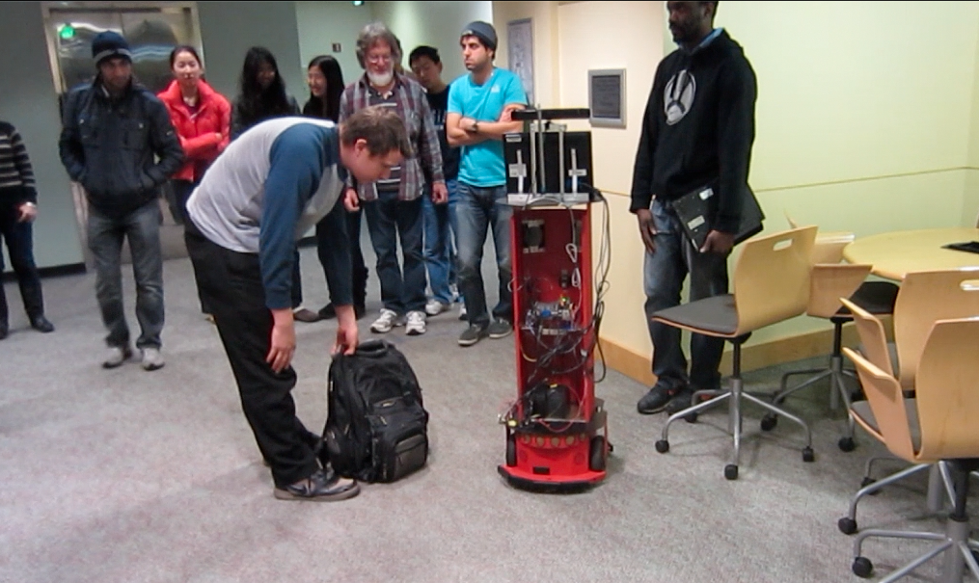
The GuideBot in action – avoiding an obstacle (the bag) and returning to the original path

Slide 15
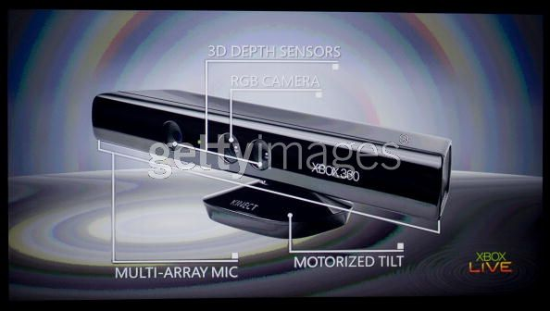
VISION HARDWARE Microsoft Kinect

Slide 16
Plans for GUIDE_BOT expansions
Fix the sonar array, there should be two complete rings, top and bottom (hardware)
Add the side sensors for close proximity to walls (hardware)
Improve localization building from all sonars and integrate with proximity sensors
Add head with neck
Add second Kinect

Slide 17
MCECS_BOT

Slide 18
Considerations about the BASE OF THE MCECS_BOT

Slide 19
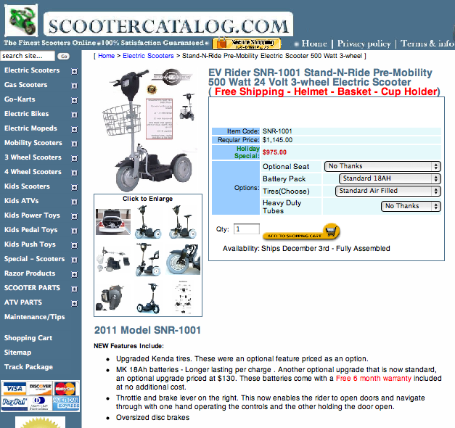

Slide 20
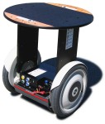
Segway RMP 100 (Robotic Mobility Platform)

Slide 21
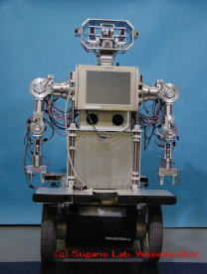
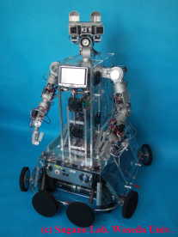

Slide 22
Sequence of projects

Slide 23
BODY OF THE ROBOT

Slide 24
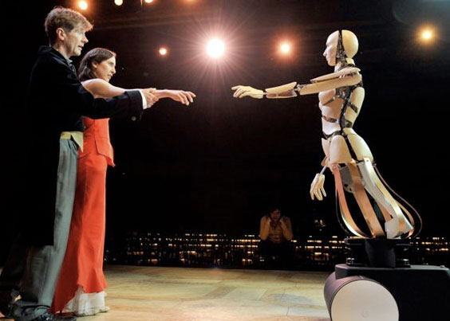
base
Wheelchair
Cart for disabled like Schauman
FIRST
FTC

Slide 25
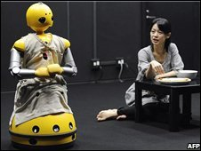

Slide 26
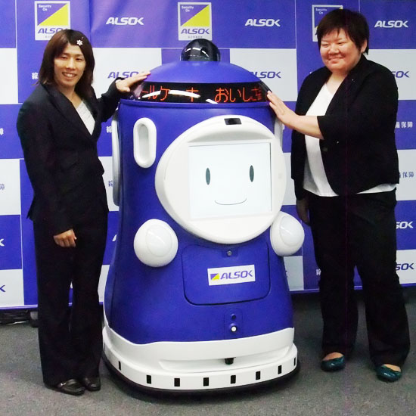

Slide 27
6. Retail Robot to Provide Interactive Ads
An9-PR, on sale in 2010, is a robot which pitches digital ads in public spaces and high traffic areas. The robot has a built-in touch screen LCD that allows people to quickly access ad information and details regarding the surrounding shopping area.

Slide 28
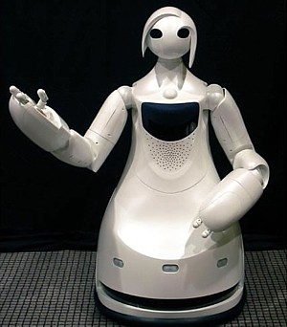

Slide 29
HEAD OF MCECS_BOT

Slide 30
Degrees of freedom on the neck/head. Base of the neck (yaw), middle of neck (pitch), and top/face (roll).

Slide 31
HEAD OF GUIDE_BOT

Slide 32
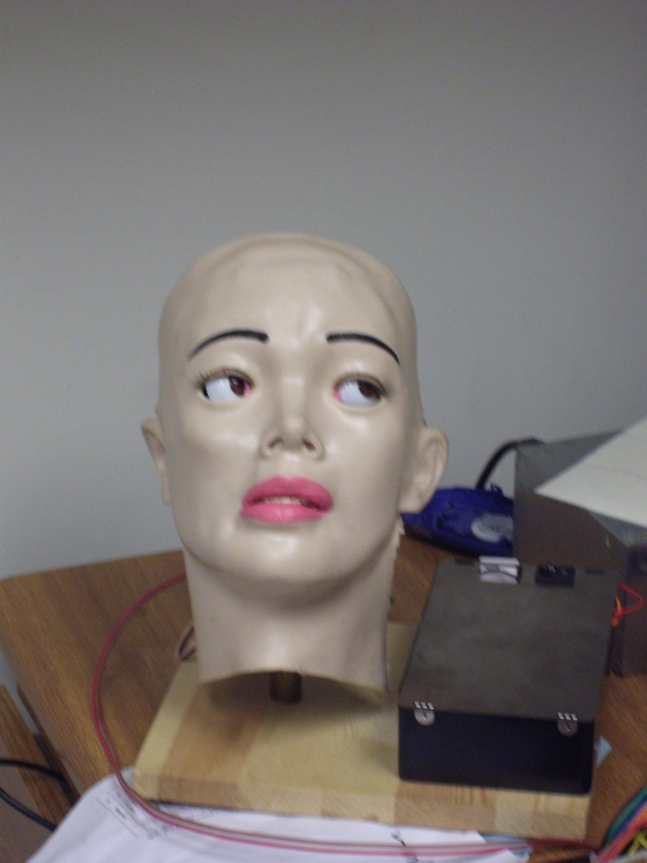

Slide 33
Head variants robotic
Head variants woman
Narrator woman from Korea
Marie Curie
DIM
Head variants man
Head variants animals
Elvis Presley
Albert Einstein
Perkowski
Dean Su
McNames
Gorilla

Slide 34
Analysis: Dimensions

Slide 36
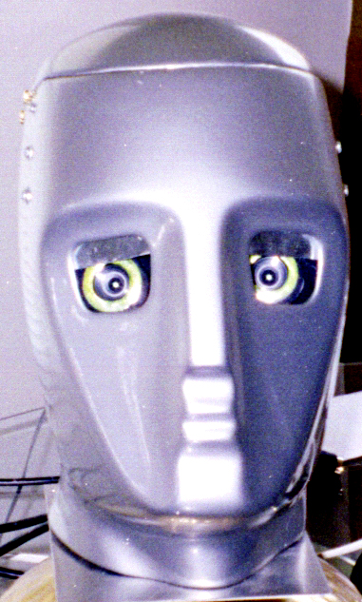

Slide 37
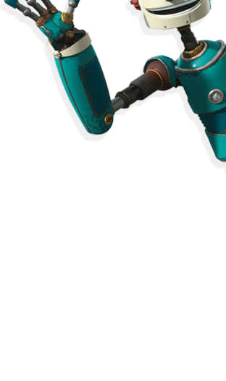

Slide 38
ARM OF MCECS_BOT

Slide 39
Arm and hand degrees of freedom. Bottom left is the hand (prism-shaped), and top right is the shoulder.

Slide 40
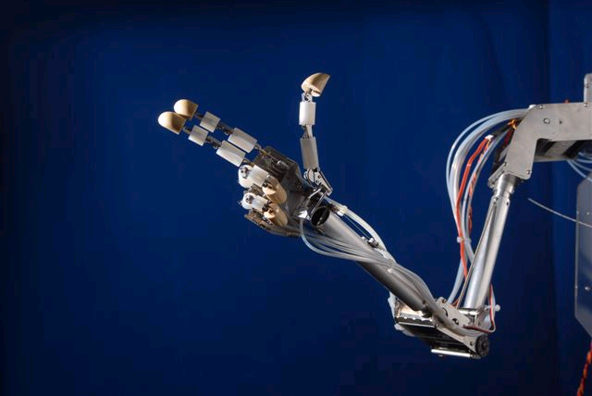
Hand

Slide 41
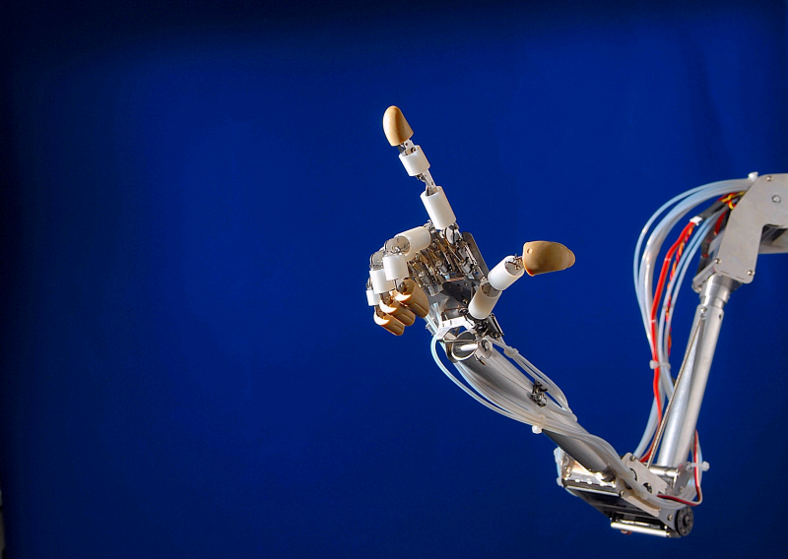

Slide 42
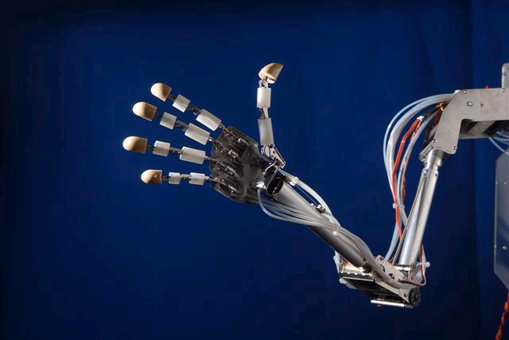

Slide 43
OTHER GENERAL PHYSICAL DESIGN CONCEPTS

Slide 44
Type of Robot Desired by High School Students Omnidirectional Robot (Everyone voted for this type of robot, not scooter): Companies: Airtrax (Forklift) Wheelchair (http://car.pege.org/2006-ever-monaco/wheel-chair.htm) 8" mecanum wheel (http://www.robotshop.com/andymark-4-wheel-mecanum-set-8in.html) 8" Omnidirectional wheel (http://www.andymark.com/product-p/am-0560.htm) 10" mecanum wheel (http://www.andymark.com/product-p/am-0584.htm) 10" steel mecanum wheel (http://www.andymark.com/product-p/am-0298.htm) 25" mecanum wheel? (http://www.omnixtechnology.com/direct_components.html)

Slide 45
Type of Robot desired by high school students: Gender of the robot : Female (also promotes female engineering) Type of the robot face: Cartoon character? (copyright issues?) Daughter of Homer Simpson Many faces Selection of faces Art student draw art, scan into program Body of the robot: Standing robot with hands Head motions for for neck (3 DOF): Wave Noding Dancing Change attention from human to human in a group Facial expressions for Ipad. Arm/hand motions Shake hands Body motions Dancing Stretching Different Greetings Shaking

Slide 46
Type of Robot desired by High School Students: Scenario: If high school students come Questions of students Ask about the departments Ask about Portland night life Ask about tourism Ask about weather Ask about financial aids Ask about housing Ask about ethnic food Ask about subjects Advertise about subjects for department Student diversity Student teacher ratios Support/assistance Student research Student ceremonies Student insurance Crime rate

Slide 47
Contacts to Team Spring 2012
Omar Mohsin oqmohsin@gmail.com
Will help
David Gaskin <d.b.gaskin@gmail.com>
Mathias Sunardi msunardi@cecs.pdx.edu
Will help
Ali Alnasser <alnas2@pdx.edu>,
Marek Perkowski <mperkows@cecs.pdx.edu>,
James Tripp <trippj25@gmail.com>,
David Glover <david.glover.or@gmail.com>

Slide 48
Team
1 | Omar Mohsin | oqmohsin@gmail.com | base
2 | Ali Alnasser | alnas2@pdx.edu | base
3 | David Gaskin | d.b.gaskin@gmail.com | waist
4 | Mathias Sunardi | msunardi@cecs.pdx.edu | manager | vision
5 | James Tripp | trippj25@gmail.com | arms
6 | David Glover | david.glover.or@gmail.com | Wall following
7

Slide 49
1 | Omar Mohsin | oqmohsin@gmail.com | base
2 | Ali Alnasser | alnas2@pdx.edu | base
3 | David Gaskin | d.b.gaskin@gmail.com | waist
4 | Mathias Sunardi | msunardi@cecs.pdx.edu | Vision/face | manager
5 | James Tripp | trippj25@gmail.com | arms
6 | David Glover | david.glover.or@gmail.com | Wall following | Data base
7 | vietnam |  | Wall following
8 | Tochi |  | Wall following
9 | Steven Huerta |  | Face/neck
10 | Robert Fiszer |  | natural language
11 | Danny Voils |  | vision
12
13
14

